Slide 1

PhD Supervisors Meeting
01/03/24

Slide 2

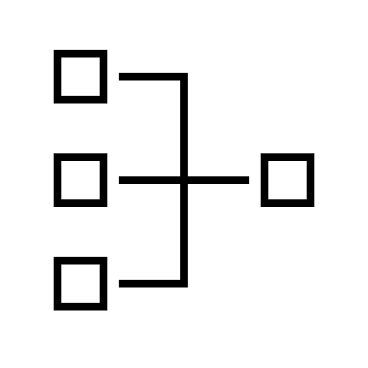

Agenda
REFINED RESEARCH
QUESTIONS
SYSTEM GRAPHIC
ARTICLE SEARCHES

Slide 3
Exploring Research Questions

Slide 4
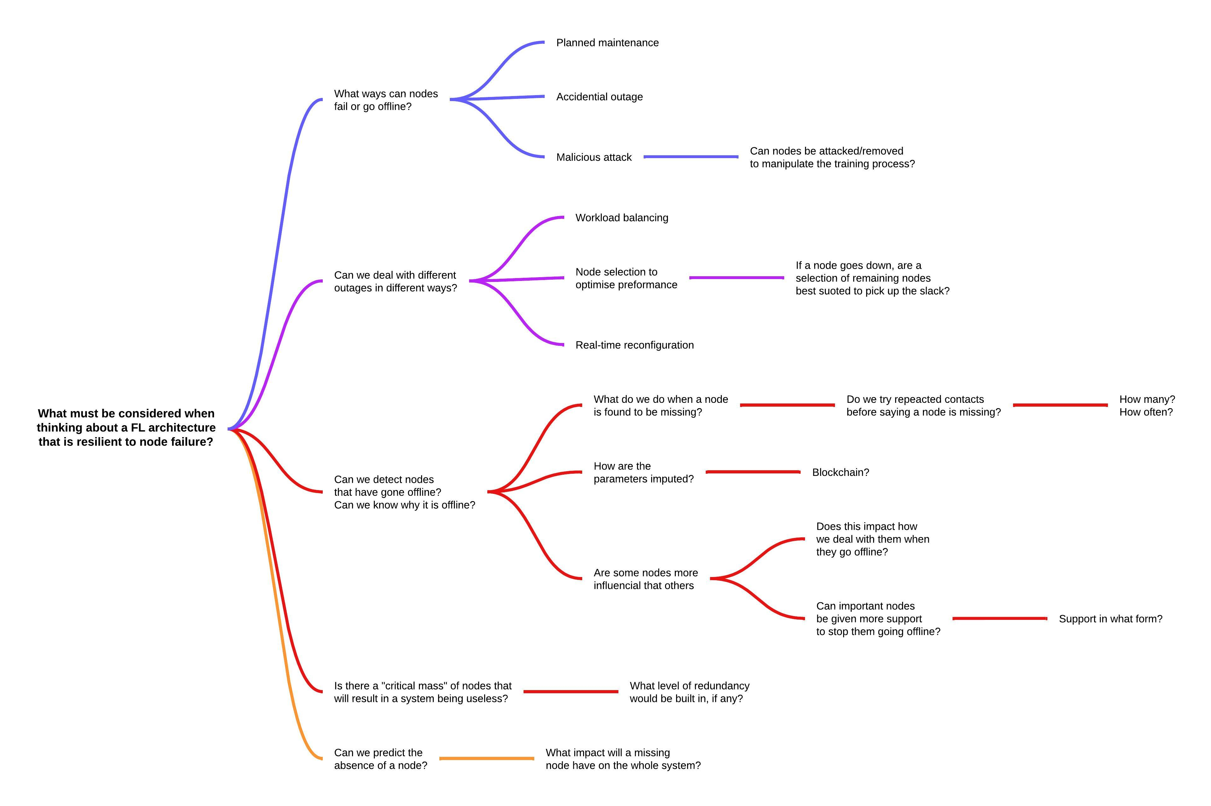
Research Question 1
In any large distributed network, there is a chance that some nodes can be lost, for a range of reason. Can a FL architecture be designed to be resilient, allowing it to identify missing nodes, and adapt so that there is no loss in performance?

Slide 5
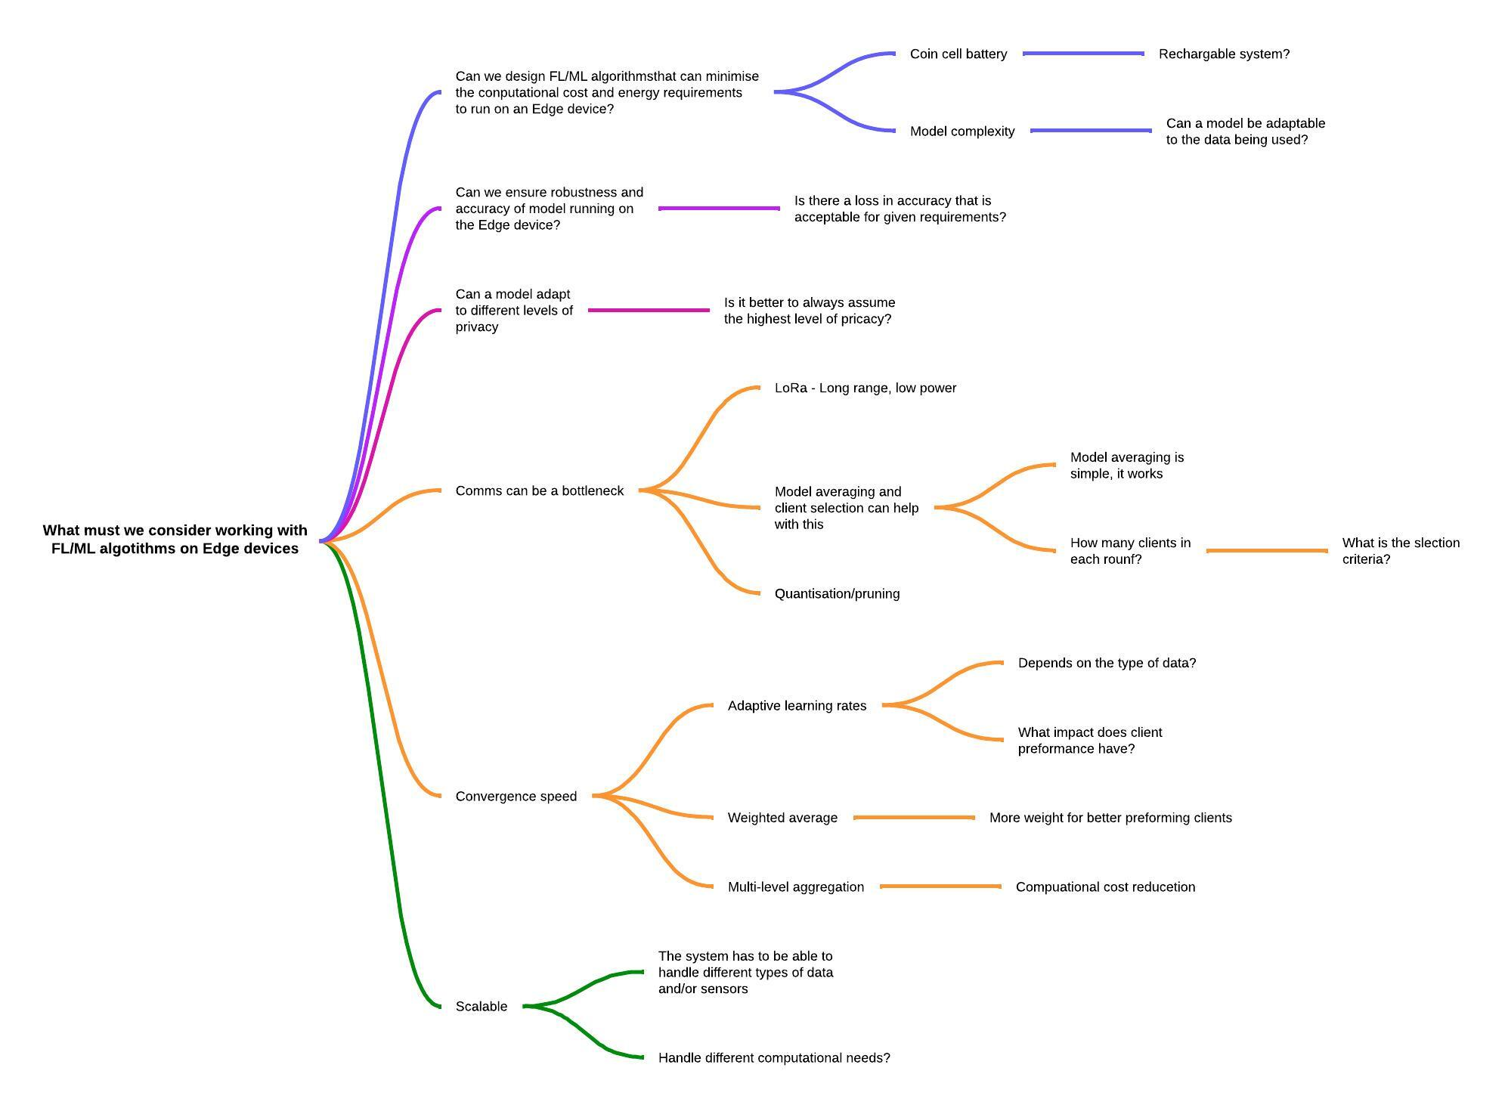
Research Question 2
With the ever-increasing use of IoT devices, can FL algorithms or tools be designed to operate specifically on Edge devices to minimize computational and costs. The models should be adaptable to a range of data sources and types.

Slide 6
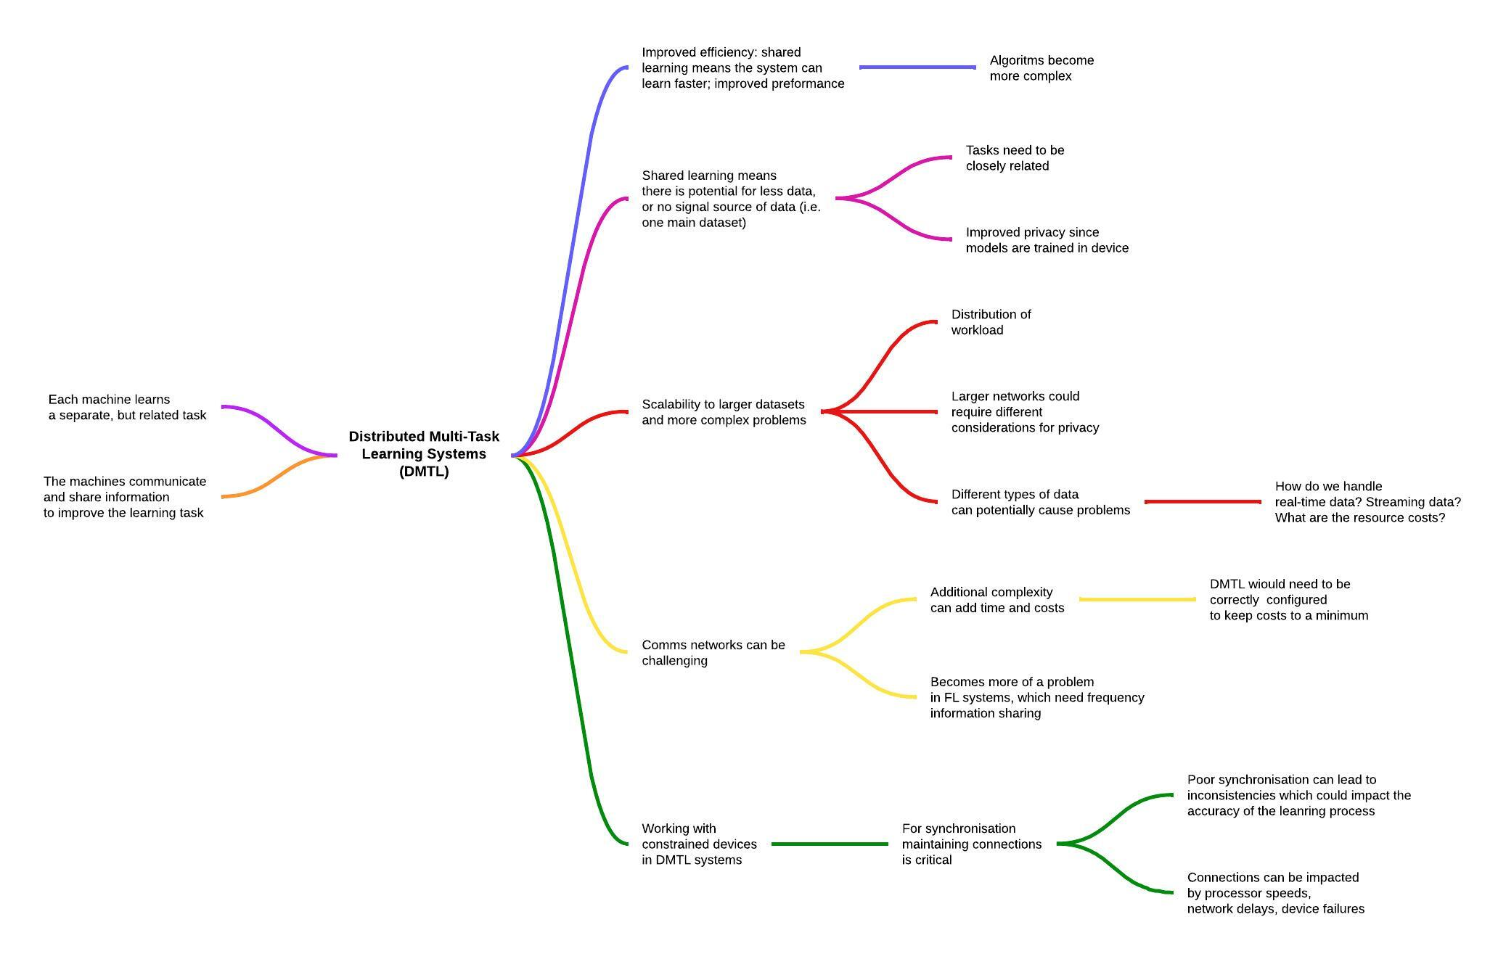
Research Question 3
Can we design FL systems that work within a distributed multi-task learning system?

Slide 7
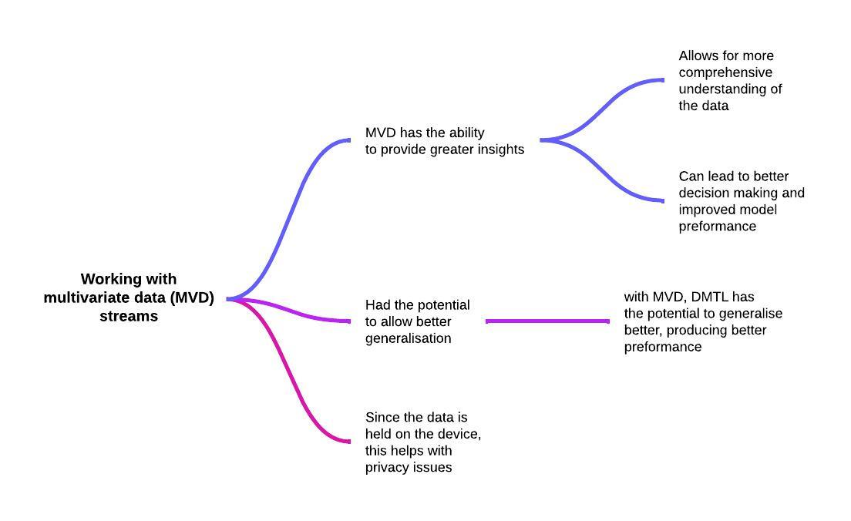
Research Question 4
Multi-variate Data

Slide 8
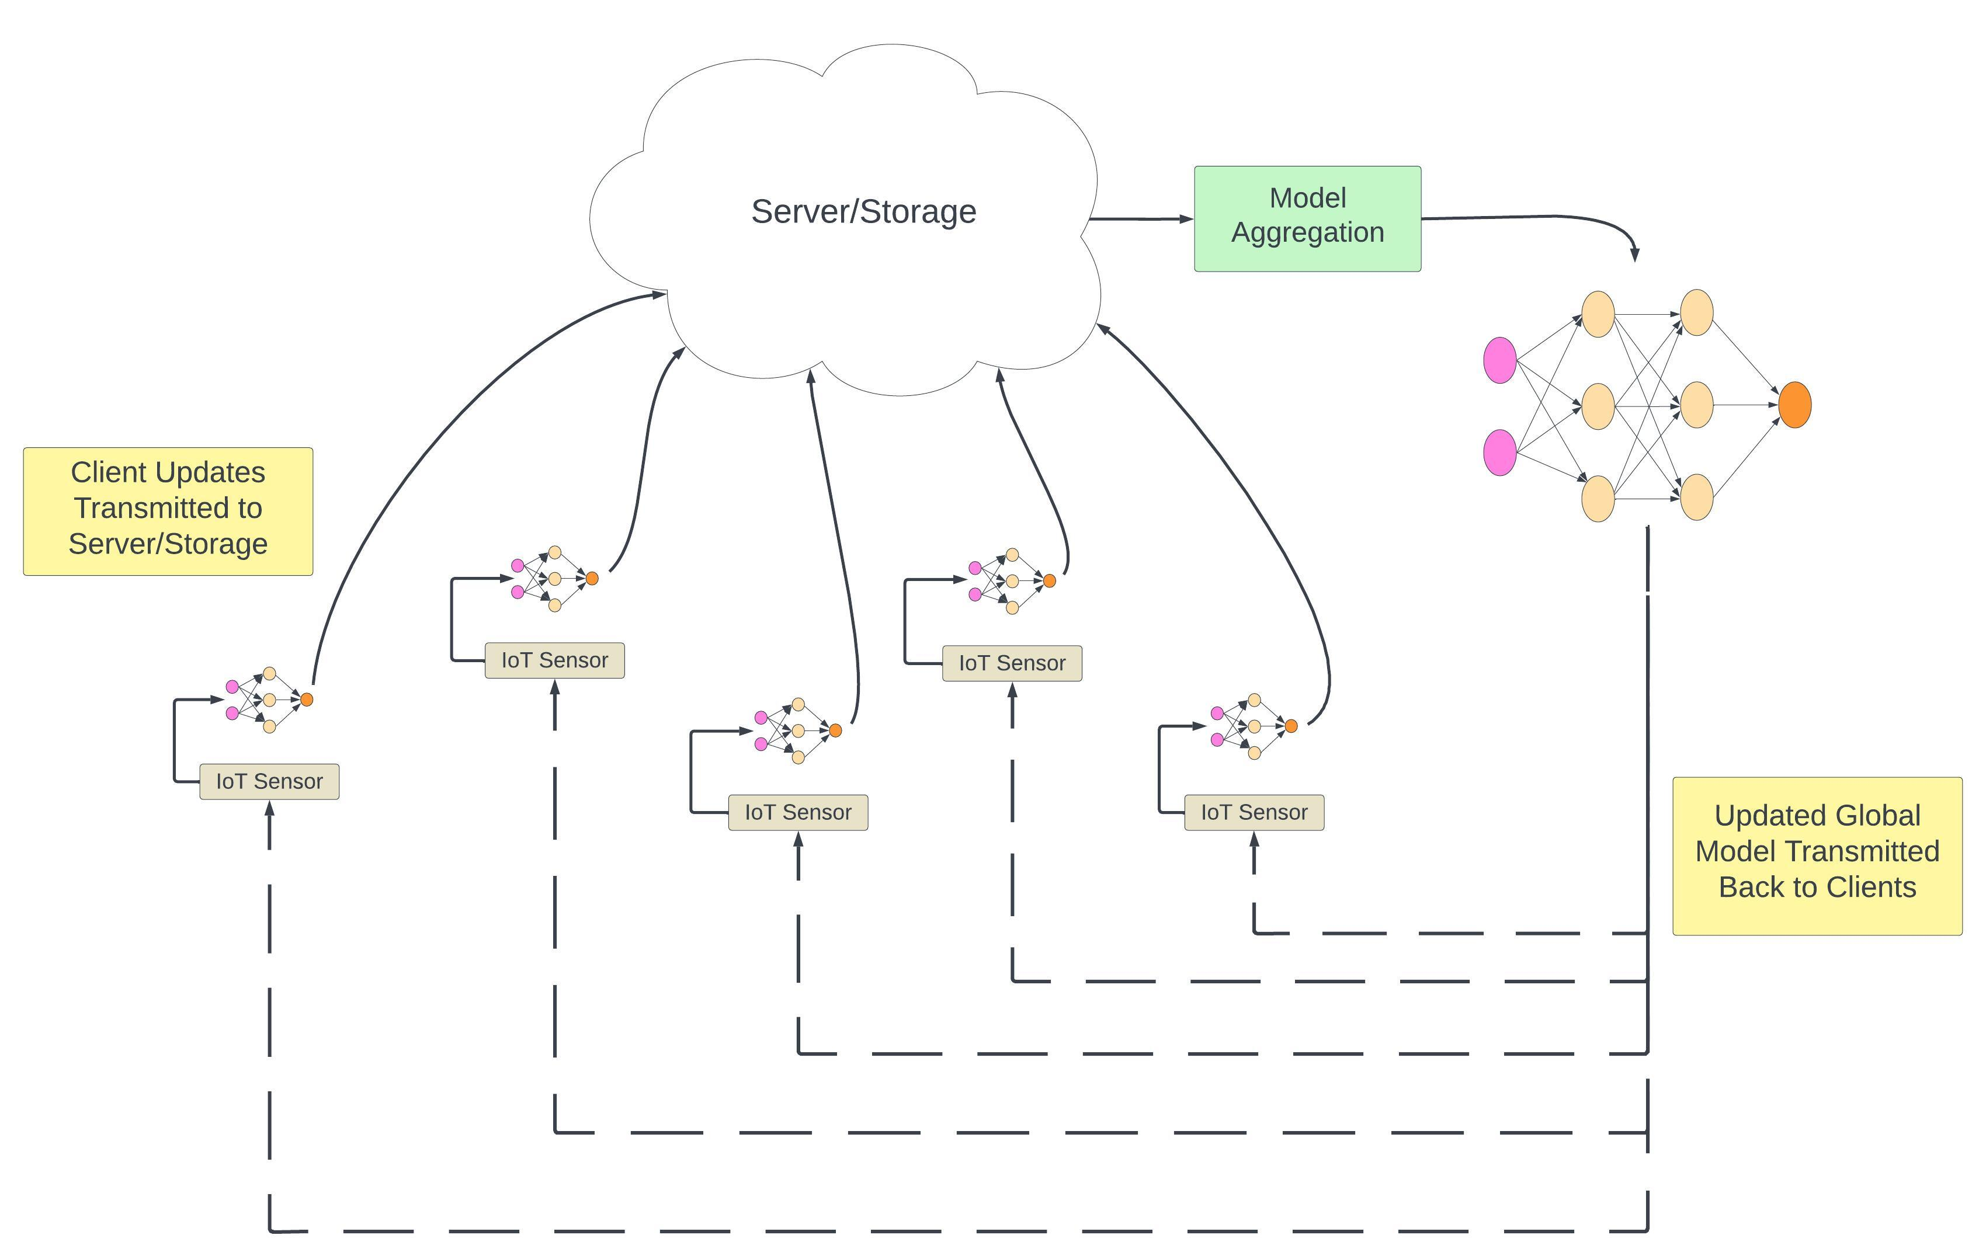
Federated Learning Diagram

Slide 9
Backup

